Slide 1
Karnatak Science College, Dharwad. GOVERNMENT PRINTING PRESS. UNDER THE GUIDANCE OF Shri. Rajshekhar V.B. Presented by Priyanka S Ganachari (15M10016) Ruksarbanu M Patil (15M10019)

Slide 2
Introduction
The web application developed for Government printing press situated in Dharwad.
User can view various services.
Place the order from the workplace itself.

Slide 3
Existing system
No platform for govt. user and customer to view services offered by the government printing press.
Manually entering details.
Overhead cost.
Storage and retrieval problem for the administrator.
Time consumption is more.

Slide 4
Proposed system
Provides platform for govt. users and customers to view various services.
The administrator receives order, and sends the confirmation message to users.
Maintain all the details of the government printing press.
Provision for feedback to both govt. user and customer.

Slide 5
Modules
Admin
The admin can add, update, delete details of the product.
The application should provide the interface for admin to maintain product details, customer details, product category details, form details, govt.user details and employee details efficiently.
The application should provide the interface for admin to view feedback.

Slide 6
Govt. user
The application should provide interface for govt.user to view various kinds of services offered by the government printing press and order the product.
The application should provide interface for govt.user to give feedback.
Customer
The application also provide interface for the customers to view various kinds of books offered by the government printing press.
The application should provide interface for customer to give feedback.

Slide 7
Software and Hardware Requirements
Software requirements:
Operating System : Windows 7 & above.
Text Editor : Brackets.
Front end : HTML ,CSS & Bootstrap.
Middle ware : PHP, Java script.
Back end : MySQL.
Server : XAMPP.
Hardware requirements:
Memory : 2GB RAM and above.
Hard disk : 100GB and above.
Processor : CORE i3 and above.

Slide 8
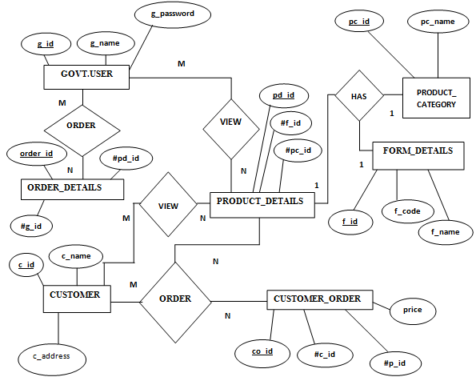
E-R diagram.

Slide 9
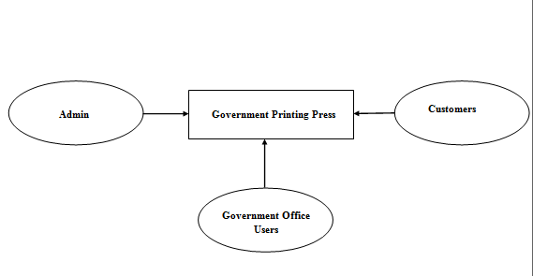
DATA FLOW DIAGRAM
Context level

Slide 10
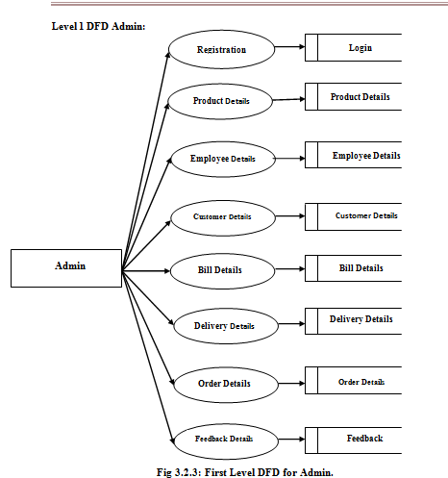
First level Dfd for admin

Slide 11
First level DFD: Govt User
Registration / Login
Govt User
Confirm Order Request
Order Details
Govt User
Gives Feedback
Feedback
Product Details
Product details

Slide 12
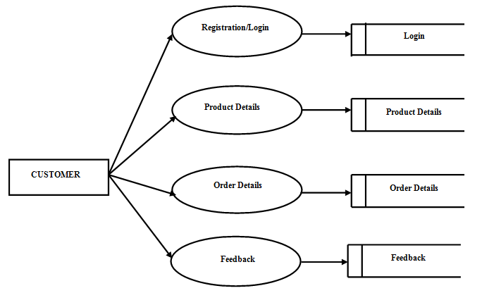
First level DFD: Customer

Slide 13
Future enhancement
Online payment gateway by using credit cards and debit card.
Details of other departments can be embedded in the application.
CONCLUSION
This web application has been developed as per the requirements.
This will provide one stop solution for their problems.

Slide 14
THANK YOU, Have a nice day.

